Slide 1
Forward-thinking
Solutions to leverage
the fourth industrial revolution
^{phone conference call}
^{Pesaro, 4 p.m. – May 14th}
^{Mr. A.} ^{Amurri}
^{www.biessegroup.com}
^{investor relator}

Slide 2
Biesse highlights IQ 2018
orders intake: +10.5%
backlog: +24.2%
group: nr. 4,161
(including temporary people)
net sales: € 162.3 (+0.5%)
net financial position.: positive € 18.9
ebitda: € 19.8 (incidence on sales 12.2%)
ebit: € 13.9 (incidence on sales 8.6%)
net result: € 8,1 (incidence on sales 5,0%)
€/mln

Slide 3
Extract of the P&L – IQ 2018
€/mln | FY 2013 | FY 2014 | FY 2015 | FY 2016 | FY 2017 | IQ 2017 | IQ 2018
Net sales year -1 | 378.4 -1.2% | 427.1 +12.3% | 513.1 +21.5% | 618.5 +19.1% | 690.1 +11.6% | 161.5 | 162.3
Value added % | 143.5 37.3% | 163.1 33.6% | 212.4 40.3% | 252.4 40.8% | 288.6 41.8% | 69.7 43.2% | 69.7 43.0%
Labour cost % | 112.7 23.8% | 128.2 30.0% | 148.2 28.6% | 176.6 28.6% | 199.1 28.9% | 48.2 29.8% | 50.0 30.8%
EBITDA % | 30.3 8.2% | 40.3 3.6% | 64.1 12.4% | 75.8 12.3% | 89.5 13.0% | 21.6 13.4% | 19.8 12.2.%
EBIT % | 18.1 4.8% | 26.5 6.2% | 43.8 8.4% | 55.1 8.9% | 63.6 9.2% | 16.1 10.0% | 13.9 8.6%
tax rate 36.8% 37,2%

Slide 4

Group orders
Intake & backlog
IQ 2018 Group orders intake +10.5% (vs. IQ 2017)
IQ 2018: Group backlog +24% (vs. IQ 2017)
€/mln
2009
2010
2011
2012
2013
2014
2015
2016
2017
IQ 2017
IIQ 2017
IIIQ 2017
IVQ 2017
IQ 2018
only machines

Slide 5
Net
debt
€/mln
2011
2012
2013
2014
2015
2016
2017
2018e
2019e
2020e

Slide 6
Net Financial Position trend – first quarters
€/mln
IQ 2009
IQ 2010
IQ 2011
IQ 2012
IQ 2013
IQ 2014
IQ 2015
IQ 2016
IQ 2017
IQ 2018
FY 2003
FY 2010
FY 2011
FY 2012
FY 2013
FY 2014
FY 2015
FY 2016
FY 2017

Slide 7
Cashflow
net debt
€/mln | 2013 | 2014 | 2015 | 2016 | 2017 | IQ 2018 | 2020e
Gross Cashflow % net sales | 52.0 13.8% | 38.3 9.0% | 46.3 8.9% | 45.8 7.4% | 75.4 10.9% | -2.5 -1.6% | 95.2 10.5%
Investments % net sales | -19.8 5.2% | -20.8 4.9% | -25.2 4.9% | -32.0 5.2% | -39.2 5.7% | -8,9 5.5% | -50.5 5.6%
Net Cashflow % net sales | 32.2 8.5% | 17.5 4.1% | 21.1 4.1% | 13.8 2.2% | 36.2 5.2% | -11.4 -7.0% | 44.7 4.9%
dividends |  | -4.8 0.18 per share | -9.8 0.36 per share | -9.8 0.36 per share | -9.8 0.36 per share | 0 | -16.6 30% of net profit
Δ Net Debt |  | 12.7 | 11.3 | 4.0 | 26.4 | -11.5
Net Debt | -23.9 | -11.3 | 0.0 | 4.0 | 30.4 | 18.9 | 104.7

Slide 8
Biesse highlights IQ 2018
Orders & Sales breakdown

Slide 9
Sales breakdown- March 2018
Italy 15.7%
Italy 14.2%
by business divisions
by main geo-areas
Italy 16.6%

Slide 10



SOPhia IS BORN
BIESSE CHOSE ACCENTURE’S INDUSTRY X.0 TO LEAD IN THE NEW
SOPHIA is the IoT platform, created by Biesse in collaboration with Accenture, which enables its customers to access a wide range of services to streamline and rationalise their work management processes.
Smart Products
Know-How, expertise and resources
Smart Services
ERVICES
PTIMIZATION
REDICTIVITY
UMAN
NNOVATION
NALYSIS
New Customer Experiences

Slide 11


01
Iiot - SOPHIA
IoT Biesse Service Pack
Priority service and extended coverage
Continuous connection with the Biesse control center
Direct monitoring of machine performance through a dedicated app
Analysis of machine downtime, remote diagnostics and fault prevention
On-site functional checks and technical inspections within the warranty period
Proactive call after machine downtime notification
Extended hours for service coverage from 8 to 12 hours per day

Slide 12

SOPHIA IS STILL EVOLVING
SERVICES
Biesse supports its customers, offering technological connectivity, sharing of expertise, professional consulting services, training and ongoing assistance.
PREDICTIVE
SOPHIA helps to prevent problems that could damage customer production. Biesse takes proactive steps to contact customers, reducing machine downtime and inefficient wasted time.
ANALYSIS
The information gathered and analysed is transformed into useful indications for optimising customer production and product quality, providing extremely opportunities for growth.

Slide 13
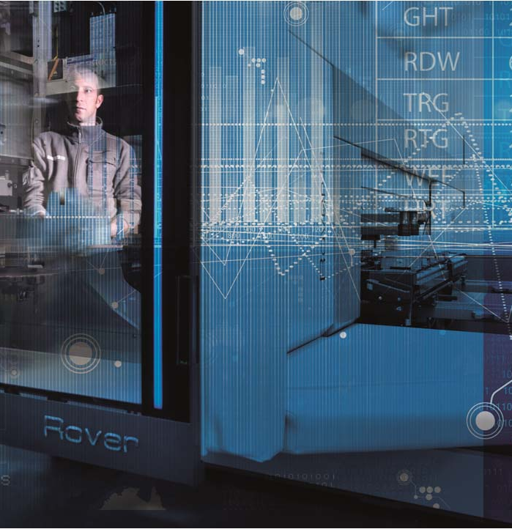
TO ACHIEVE Great Results
Route to new services
With its new IIOT platform, Biesse is transforming itself from product-oriented manufacturer to a digital business offering to its customers value added services
20.000
Connected machines
by 2020

Slide 14
Biesse highlights IQ 2018
Group people distribution

Slide 15
People distribution
(without interim people)
 | FY 2010 | FY 2011 | FY 2012 | FY 2013 | FY 2014 | FY 2016 | FY 2016 | FY 2017 | IQ 2018
Production % of total people | 965 41% | 1.250 46% | 1.265 45% | 1.175 44% | 1.201 42% | 1.335 42% | 1.482 41% | 1.494 39% | 1.550 39%
Service & After sale % of total people | 568 24% | 577 21% | 574 21% | 613 22% | 628 22% | 690 22% | 803 22% | 894 23% | 920 23.2%
R&D % of total people | 293 12% | 316 12% | 338 12% | 321 12% | 361 13% | 383 13% | 436 12% | 479 12.5% | 498 12.5%
Sales & Marketing % of total people | 340 13% | 361 13% | 364 13% | 351 13% | 439 15% | 495 15% | 587 16% | 641 17% | 654 16%
G & A % of total people | 202 9% | 233 9% | 242 9% | 235 9% | 252 9% | 273 9% | 310 8.5% | 338 8.8% | 346 8.7%
ITALY % of total people | 1.660 70% | 1.656 61% | 1.646 59% | 1.547 57% | 1.605 56% | 1.780 56% | 2.009 56% | 2.176 56% | 2.296 58%
OUTSIDE ITALY** % of total people | 708 30% | 1.081 39% | 1.136 41% | 1.148 43% | 1.276 44% | 1.396 44% | 1.609 44% | 1.670 44% | 1.672 42%
TOTAL | 2.368 | 2.737 | 2.782 | 2.695 | 2.881 | 3.176 | 3.618 | 3.846 | 3.968

Slide 16
People distribution
 | FY 2010 | FY 2011 | FY 2012 | FY 2013 | FY 2014 | FY 2015 | FY 2016 | FY 2017 | March 2017 | March 2018
ITALY % of total people | 1660 70% | 1656 61% | 1646 53% | 1547 57% | 1605 56% | 1780 56% | 2009 56% | 2176 56% | 2060 56% | 2296 58%
OUTSIDE ITALY** % of total people | 708 30% | 1081 33% | 1136 41% | 1148 43% | 1276 44% | 1336 44% | 1609 44% | 1670 44% | 1630 44% | 1672 42%
TOTAL | 2368 | 2737 | 2782 | 2695 | 2881 | 3176 | 3618 | 3846 | 3,690 | 3,968
+7.5%
interim people at the end of March 2016: 138
interim people at the end of March 2017: 185
Interim people at the end of March 2018: 193 (4.6%)
IQ 2018: 4,161

Slide 17
Biesse three years plan 2018-2020: targets
net sales c.a.g.r.: 9.5%
ebitda c.a.g.r.: 12.4%
ebit c.a.g.r.:14.6%
net profit c.a.g.r.: 13.5%
(

Slide 18
Biesse three years plan 2018-2020: targets
capex intangible & tangible
> € 142 mln (3 years total amount)
positive net financial position
more positive net financial position
net financial position
positive for more than €104.7 mln
2020e
dividends policy
30% of the net profit
o.n.w.c. incidence against net sales less than 8%
2018e

Slide 19
growth driver: main factors
urbanization factor (China)
substitution cycle (western economies)
digitalization demand - energy efficiency (worldwide)
software integration increase – Industry 4.0 capabilities and incentives
diversification into new segments

Slide 20
Shareholders
shareholders and B.o.D. structure

Slide 21
Shareholders breakdown by ownership – Board of Directors
€/MIL
Bi.Fin s.r.l (Selci family)
free float
Biesse B.o.D.:
Giancarlo Selci (founder - president)
Roberto Selci (C.E.O.)
Stefano Porcellini (Group Director)
Alessandra Parpajola
Giovanni Chiura (indipendent)
Federica Palazzi (indipendent)
Elisabetta Righini (indipendent)
Source: Bloomberg

Slide 22
Disclaimer
This presentation has been prepared by Biesse S.p.A. for information purposes only and for use in presentations of the Group’s results and strategies.
For further details on the Biesse S.p.A. reference should be made to publicly available information. including the Quarterly Reports, the Half Annual Report, the Annual Reports and the Three Years Business Plan.
Statements contained in this presentation, particularly the ones regarding any Biesse S.p.A. possible or assumed future performance, (business plan) are or may be forward looking statements and in this respect they involve some risks and uncertainties.
Any reference to past performance of the Biesse S.p.A. shall not be taken as an indication of future performance.
This document does not constitute an offer or invitation to purchase or subscribe for any shares and no part of it shall form the basis of or be relied upon in connection with any contract or commitment whatsoever.
By attending the presentation you agree to be bound by the foregoing terms.

Slide 23
biessegroup.com
Alberto Amurri
Investor Relator Manager
0039 - 0721439107
0039 - 3351219556

